Slide 1
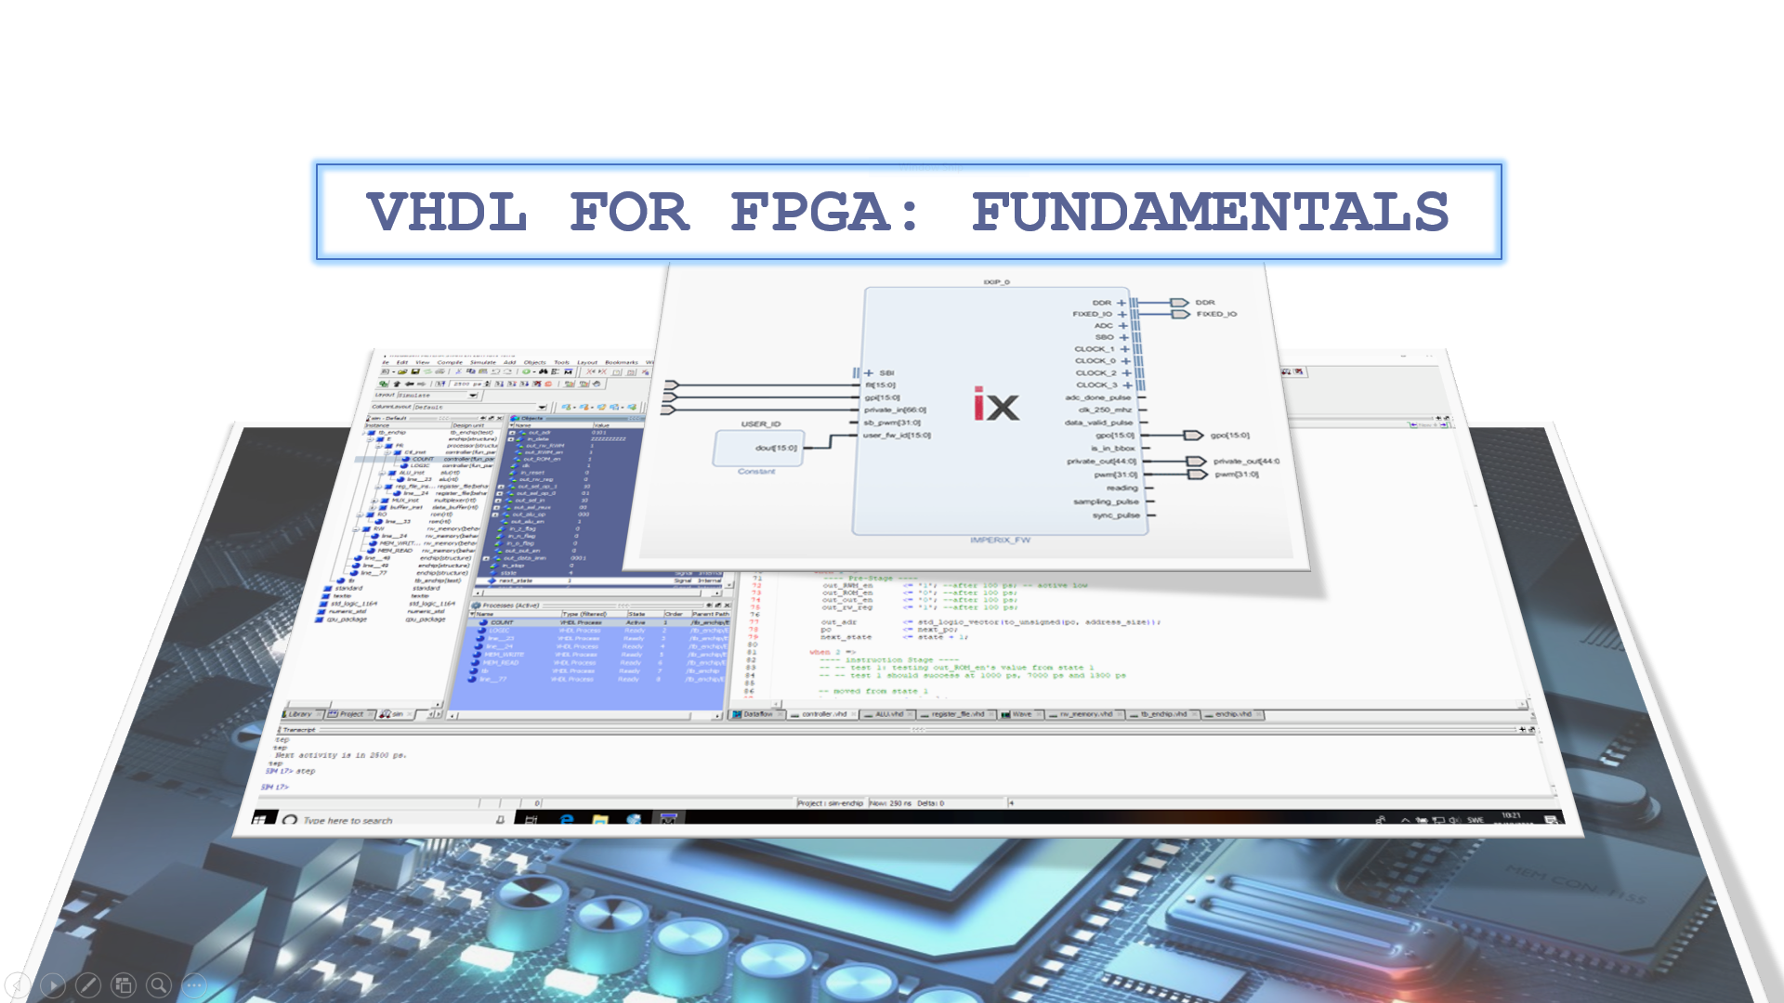

Slide 2
PART2:SEQUENTIAL CIRCUITS
SEQUENTIAL CIRCUITS
Asynchronous sequential circuits : Latches
Synchronous circuits : flip flops , counters ,registers
Testbench : Generating clock stimulus

Slide 3
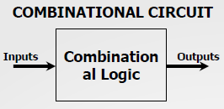
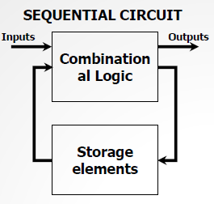
VHDL For FPGA
Combinational VS Sequential Circuits
In combinational circuits, the output only depends upon the present input values.
There exist another class of logic circuits whose outputs not only depend on the present input values but also on the past values of inputs, outputs, and/or internal signal. These circuits include storage elements to store those previous values.
The content of those storage elements represents the circuit state. When the circuit inputs change, it can be that the circuit stays in certain state or changes to a different one. Over time, the circuit goes through a sequence of states as a result of a change in the inputs. The circuits with this behavior are called sequential circuits

Slide 4
VHDL For FPGA
Sequential Circuits
Combinational circuits can be described with concurrent statements or behavioral statements.
Sequential circuits are best described with sequential statements.
Sequential circuits can either be asynchronous or synchronous . In VHDL, they are described with asynchronous/synchronous processes.
Basic asynchronous sequential circuits: Latches
Basic synchronous sequential circuits: flip flops, counters, and registers.
Here, we cover the VHDL description of typical asynchronous and synchronous sequential circuits.

Slide 5
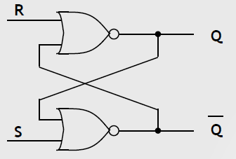
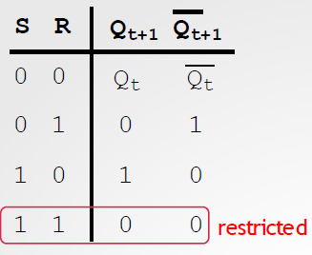
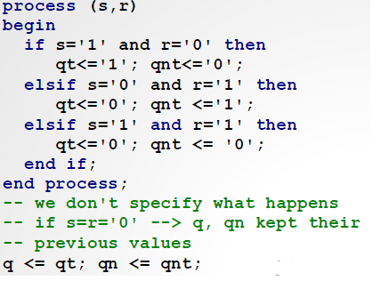
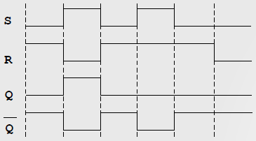
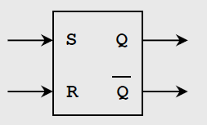
VHDL For FPGA
SR Latch (Based on NOR gates)
According to its truth table, the output can be assigned to either ‘0’or‘1’. This circuit state (‘0’ or ‘1’) is stored in the circuit when S=R=‘0’.
FPGAs usually have trouble implementing these circuits as FPGAs are synchronous circuits.

Slide 6
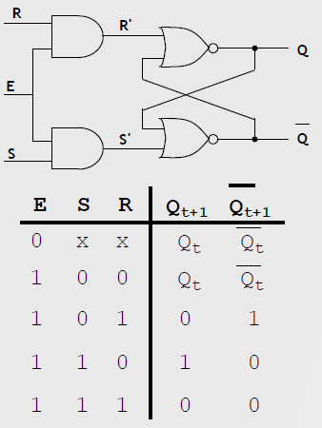
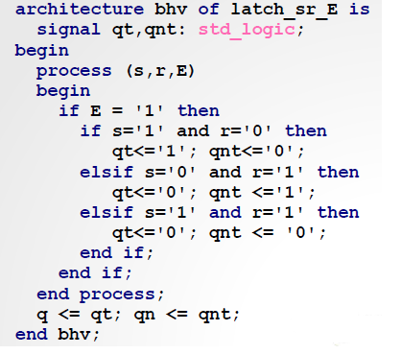
VHDL For FPGA
SR Latch With Enable
Note: If E = ‘0’, the previous output is kept.

Slide 7
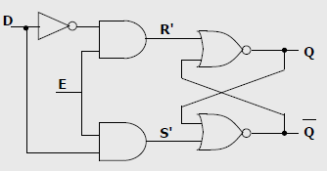
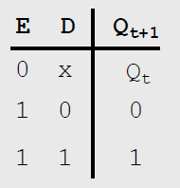
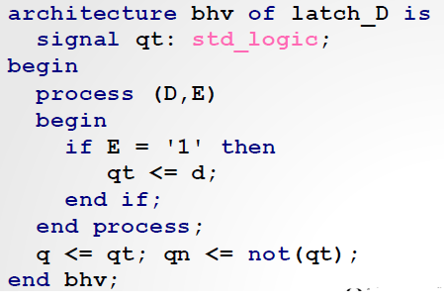
VHDL For FPGA
D Latch with Enable

Slide 8
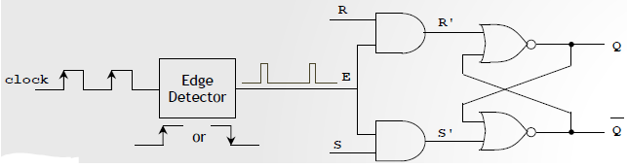
VHDL For FPGA
Synchronous Processes: Flip-Flops
Unlike a Latch, a flip flop only changes its outputs on the edge (rising or falling) of a signal called clock . A clock signal is a square wave with a fixed frequency.
To detect a rising or falling edge, flip flops include an edge detector circuit. Input: a clock signal, Output: short duration pulses during the rising (or falling) clock edges. These pulses are then connected to the enable input in a Latch.
For example, an SR flip flop is made out of: a SR Latch with an edge detector circuit. The edge detector generates enable signals during the during the rising (or falling) clock edges.

Slide 9
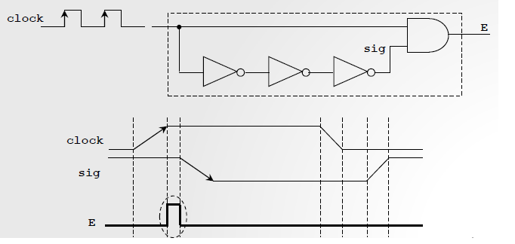
VHDL For FPGA
Flip-Flops
The edge detector circuit generates E=‘1’ during the edge (rising or falling). We will work with circuits activated by either rising or falling edge. We will not work with circuits activated by both edges.
An example of a circuit that detects a rising edge is shown below. The redundant NOT gates cause a delay that allows a pulse to be generated during a rising edge (or positive edge).

Slide 10
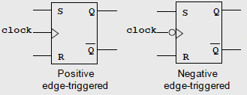
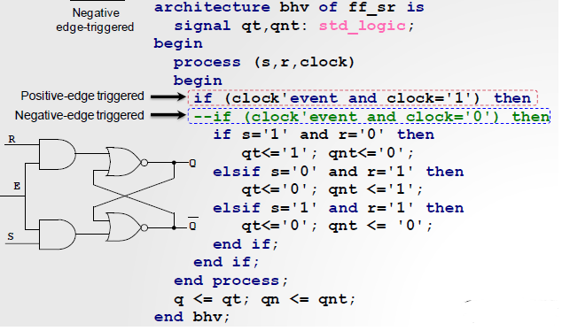

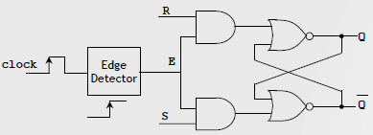
VHDL For FPGA
SR Flip Flop

Slide 11
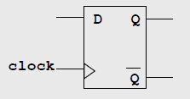
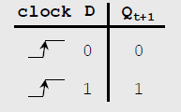
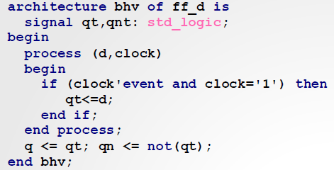
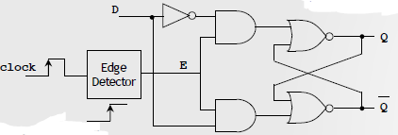
VHDL For FPGA
D Flip Flop
Note: Signal qt is needed. In VHDL, we cannot feedback an output (in this case q) as an input of the circuit

Slide 12

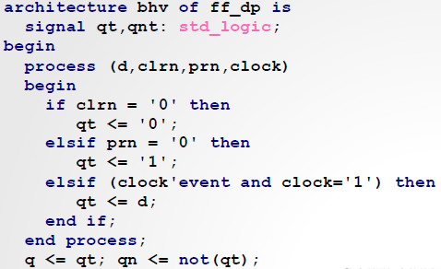
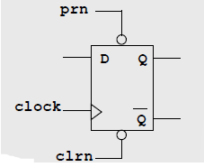
VHDL For FPGA
D Flip Flop with asynchronous inputs: clrn, prn
These inputs force the outputs to a value immediately.
This is a useful feature if we want to initialize the circuit with no regards to the rising (or falling) clock edge

Slide 13
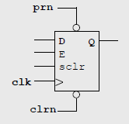
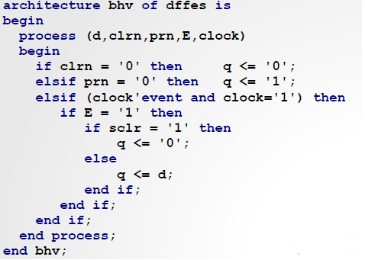
VHDL For FPGA
D Flip Flop with enable and synchronous clear
This is a complete design that includes asynchronous inputs (prn, clrn) and synchronous inputs (E, sclr, D).

Slide 14
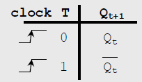
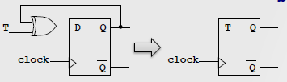
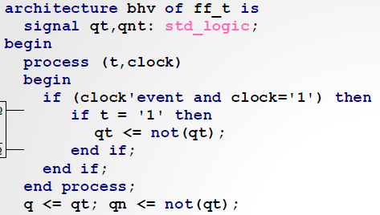

VHDL For FPGA
T Flip Flop

Slide 15
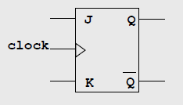
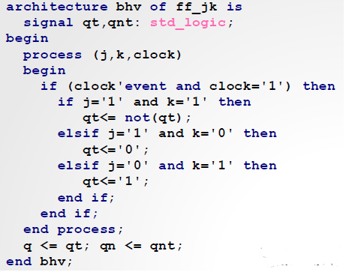
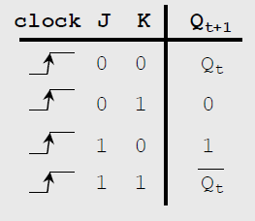
VHDL For FPGA
JK Flip Flop

Slide 16
VHDL For FPGA
Registers
These are sequential circuits that store the values of signals.
There exist many register types: registers to handle interruptions in a PC, microprocessor registers, pipelining registers, etc.
n bit Register: Storage element that can hold ‘n’ bits. It is a collection of ‘n’ D type flip flops.
Register types:
Simple Register (with/without enable)
Shift register (with/without enable)
Serial input, parallel output
Serial input, serial output
Parallel access shift register (parallel/serial input, parallel/serial output).

Slide 17
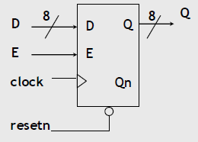
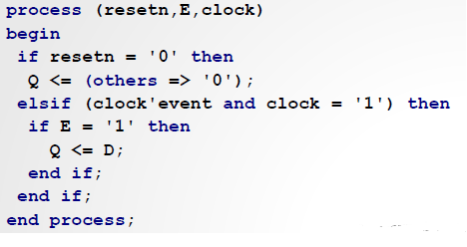
VHDL For FPGA
Parallel Load, Parallel Output
8-bit register with enable and asynchronous reset

Slide 18
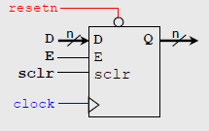
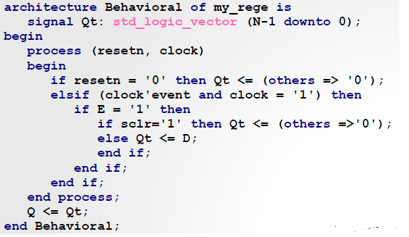
VHDL For FPGA
Parallel Load, Parallel Output
n-bit register with enable, sclr and asynchronous reset
sclr: only considered if E = ‘1’

Slide 19
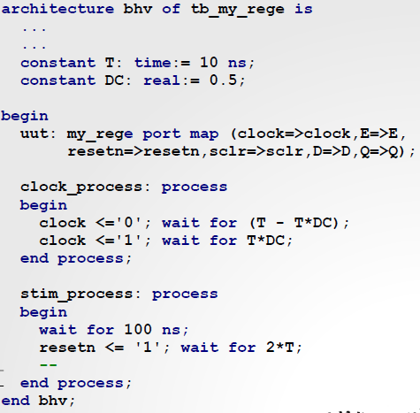
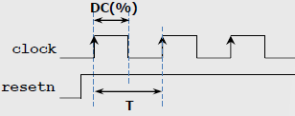
VHDL For FPGA
TESTBENCH : Generating Clock Stimulus
A clock signal is an square wave with a fixed frequency. The Duty Cycle is usually 50%.
The example a code snippet of the testbench for reg3.vhd: An independent process is needed just to create the clock signal.

Slide 20

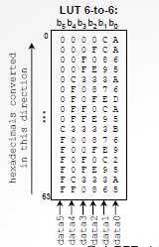
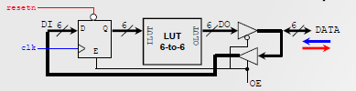
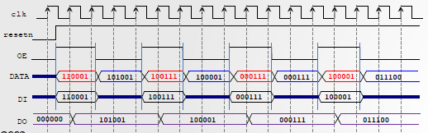
VHDL For FPGA
REGISTER: 3 state buffers and 6 to 6 LUT
LUT6-to-6: built by grouping six LUT6-to-1 in parallel. LUT6-to-1: made out of LUT4-to-1.
Note that the port DATA can be input or output at different times. In VHDL, we use the INOUT data type to specify this.
LUT6-to-6 contents: Any function of 6 input bits and 6 output bits can be pre-computed and stored in the LUT6-to-6.
In the example, the function is:

Slide 21
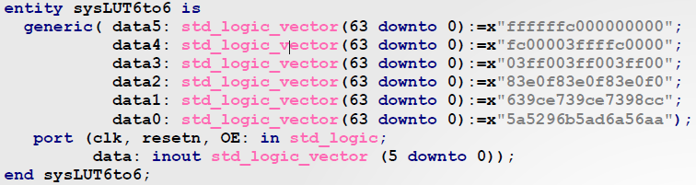
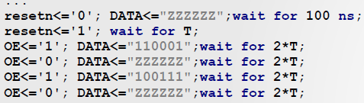
VHDL For FPGA
REGISTER: 3 state buffers and 6 to 6 LUT
Data: 64 rows of 6 bits. Or 6 columns of 64 bits. The figure shows the entity VHDL portion of the system.
Testbench: The code shows that when DATA is output (OE=0), it MUST be assigned the value ‘Z’.

Slide 22
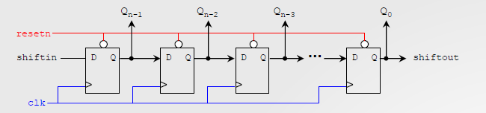
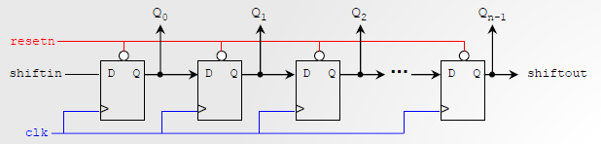
VHDL For FPGA
SHIFT REGISTER: Serial Input, Serial/ Parallel Output
n-bit right shift register:
n-bit left shift register:

Slide 23
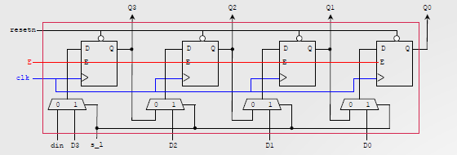
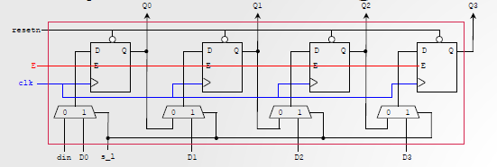
VHDL For FPGA
PARALLEL ACCESS SHIFT REGISTER:
4-bit right parallel access shift register with enable:
4-bit left parallel Access shift register with enable:

Slide 24
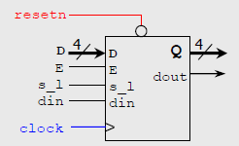
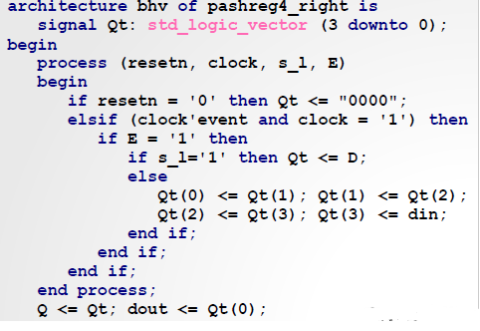
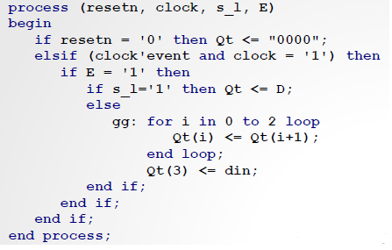
VHDL For FPGA
PARALLEL ACCESS SHIFT REGISTER:
s_l=1 : Paralled load
s_l=0 : Serial load
‘din’ : serial input
‘D’ : parallel input
‘dout’ : serial output
‘Q’ : parallel output
Parallel/serial load, Parallel/serial output
Shift to the right, 4 bits
Use of VHDL for loop

Slide 25

VHDL For FPGA
Synchronous Counters
Counters are very useful in digital systems. They can count the number of occurrences of a certain event, generate time intervals for task control, track elapsed time between two events, etc.
Synchronous counters change their output on the clock edge (rising or falling). Counters are made of flip flops and combinatorial logic. Every flip flop in a synchronous counter shares the same clock signal. The figure shows a 4 bit synchronous binary counter ( 0000 to 1111 ). A resetn signal is also included to initialize the count.

Slide 26


VHDL For FPGA
4-bit binary counter with asynchronous active-low reset
Count: 0 to 2^4-1 (once it gets to 2^4-1, it goes back to 0)
resetn: active-low signal that sets Q to 0 as soon as it is 0, with no regards to the clock
VHDL code: The behavioral style is preferred for counters (instead of the structural description).
VHDL code: integer is used instead of std_logic_vector. The number of bits (4) is automatically computed

Slide 27


VHDL For FPGA
4-bit binary counter with enable and asynchronous active-low reset
Synchronous enable signal (‘E’): Only considered on the rising clock edge.
This is also called a counter modulo-15
If Qt=1111, then Qt <= Qt+1 results in Qt=0000 (since for 4 bits, 1111+1=0000) This is true of any binary counter (0 to 2n-1)

Slide 28


VHDL For FPGA
4-bit binary counter with enable, asynchronous active- low reset and synchronous clear
The signals ‘E’ and ‘sclr’ are synchronous, thus they are only considered on the rising clock edge.
If E=sclr=1 then Qt is set to 0.
When Qt = 15, then Qt <= Qt+1 will result in Qt = 0.

Slide 29


VHDL For FPGA
BCD (or modulo-10) counter with asynchronous active-low reset
Count: 0 to 9 (4 bits)
When Qt = 9, then Qt <= Qt+1 results in Qt = 0.
Note: This behavior (9 → 0) must be explicitly specified.
This is different from the 0-to-15 counter, where the behavior (15 → 0) was implicit

Slide 30


VHDL For FPGA
4-bit synchronous up/down counter with asynchronous active-low reset
ud = 0 → down
ud = 1 → up
When Qt = 0000, then Qt <= Qt-1 will result in Qt = 1111

Slide 31


VHDL For FPGA
4-bit Synchronous counter with parallel load

Slide 32
VHDL For FPGA
The Ring Counter and The Johnson Counter
Ring Counter:
A modified shift register. The true output of the last flip-flop is fed back directly to the data input of the first flip-flop, thus generating a sequence of pulses.
For example, for a D Flip-Flop shift register, the Q output of the last flip-flop is connected to the D input of the first flip-flop. These counters are used in digital system to generate control pulses.
Ring Counter:
Johnson counter is a reverse of Ring Counter.
Feedback from the last flip-flop is fed inversely to the data input of the first flip-flop.
For example, for a D Flip-Flop shift register, the ~Q output of the last flip-flop is fed to the D input of the first flip-flop. These can be used as Divide by n counters as well.

Slide 33


VHDL For FPGA
The Ring Counter
Ring Counter:
First, we need to set the initial state 1000 through preset input.
can be implemented using JK and D flip-flops.

Slide 34

VHDL For FPGA
The Johnson Counter
First, we need to set the initial state 0000 through reset input.
can be implemented using JK and D flip-flops.
It doesn’t count in a binary sequence.
Applications:
Johnson counter divides a clock signal’s frequency by ‘2n’. n is the bit size of the counter. Johnson counter uses less number of flip-flops compare to a typical ring counter.
2-stage Johnson counter, also known as quadrature oscillator produce 4 outputs with 90-degree phase shift. It can easily drive a 2-phase stepper motor.
3-stage Johnson counter is used as 3-phase square wave generator having 120-degree phase shift between them
Pulse | Q0 | Q1 | Q2 | Q3
0 | 0 | 0 | 0 | 0
1 | 1 | 0 | 0 | 0
2 | 1 | 1 | 0 | 0
3 | 1 | 1 | 1 | 0
4 | 1 | 1 | 1 | 1
5 | 0 | 1 | 1 | 1
6 | 0 | 0 | 1 | 1
7 | 0 | 0 | 0 | 1

Slide 35
Thank You

